Slide 1
How earthquakes occur
Lecture 1

Slide 2
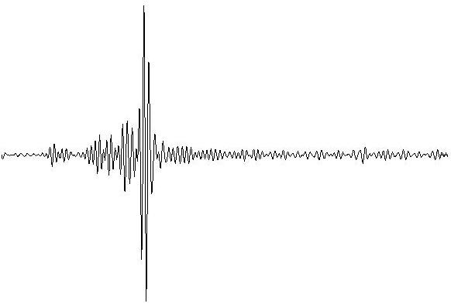
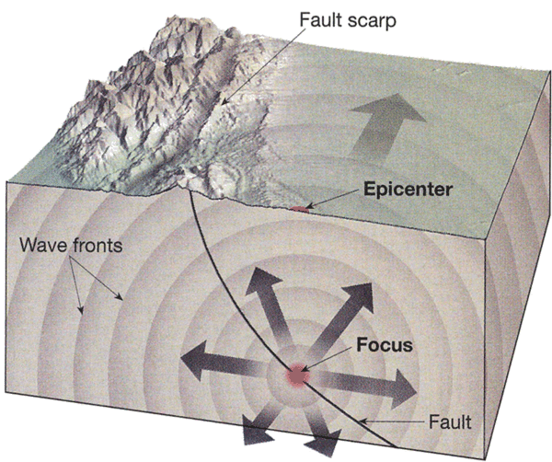
What is Seismology ?
From the Greek root word: “seismos” to shake
Seismology: the study of earthquakes and
the elastic waves generated by the rupture.
Seismic Waves: elastic wave energy
that propagates in solid or fluid materials.

Slide 3
Seismology is science dealing with all aspects of earthquakes:
OBSERVATIONAL SEISMOLOGY
1-Recording earthquakes (microseismology)
2-Cataloguing earthquakes
3- Observing earthquake effects 4- macroseismology

Slide 4
ENGINEERING SEISMOLOGY
Estimation of seismic hazard and risk
Aseismic building
‘PHYSICAL’ SEISMOLOGY
Study of the properties of the Earth’s interior
Study of physical characteristics of seismic sources

Slide 5
What is Seismology ?
Seismology bridges:
Geology + Geophysics + Earth Science
Seismic imaging at depth can verify whether geological
observations (e.g. faults, plate boundaries, ancient sutures, granitic outcrops)
on the surface continue to deeper depths in the crust or mantle.
Earthquake aftershocks can help us map faults and plate boundaries
at depth in the crust and mantle.
Volcano seismology measure earthquake patterns that may
indicate magma rising through a volcano chamber

Slide 6
What are Earthquakes?
The term “Earthquake” is shaking of the ground and to the source of the shaking
•Earthquakes occur due to Sudden motion on a fault Formation of a new fault
Slip on an existing fault
Movement of magma / explosion of a volcano
Landslides
Meteorite impacts
Underground nuclear bomb tests / mine collapses

Slide 7
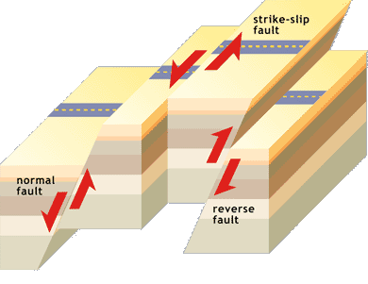
How earthquakes occur?
Earthquakes occur at FAULTS.
Fault is a weak zone separating two geological blocks.
Tectonic forces cause the blocks to move relative one to another.

Slide 8
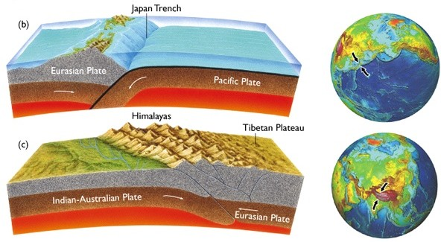
Seismology and Plate Tectonics
Earthquakes generally occur at plate boundaries.
Thus plate tectonics is intimately linked with earthquakes and seismology

Slide 9
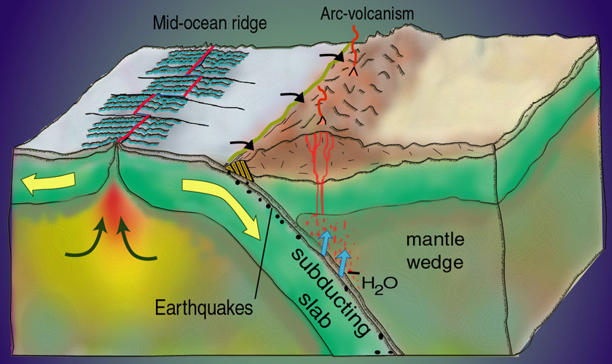
Seismology and Plate Tectonics
Most of the largest earthquakes occur at collisional plate boundaries.

Slide 10
What is the Elastic Rebound Theory?
[ Initial Conditions ] -Plate motion begins-Fence is straight[ Step 1 ]
-Plate motion continues
-Stress/strain is localized on fault
-Fence is strained/deformed
-Deformation is recoverable (elastic)[ Step 2 ]-Plate motion continues-Stress/strain exceeds rock strength-The fault slips (ruptures)-Fence is broken into two undeformed pieces

Slide 11
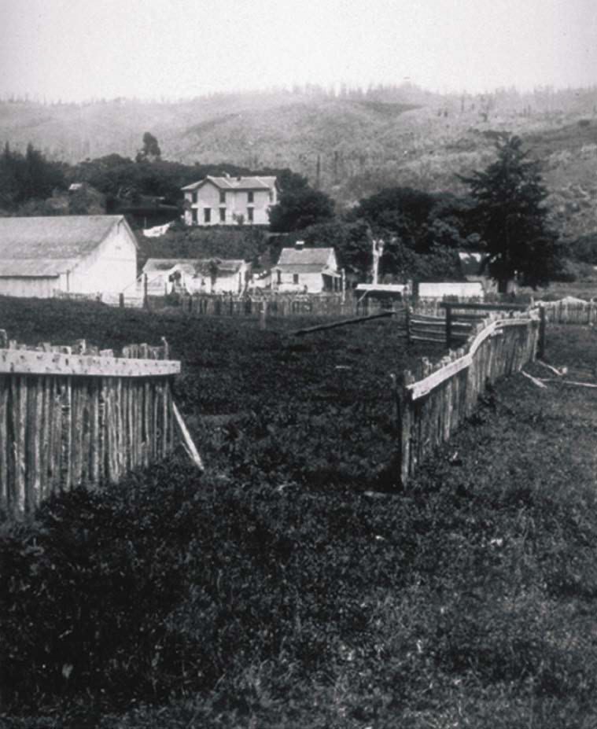
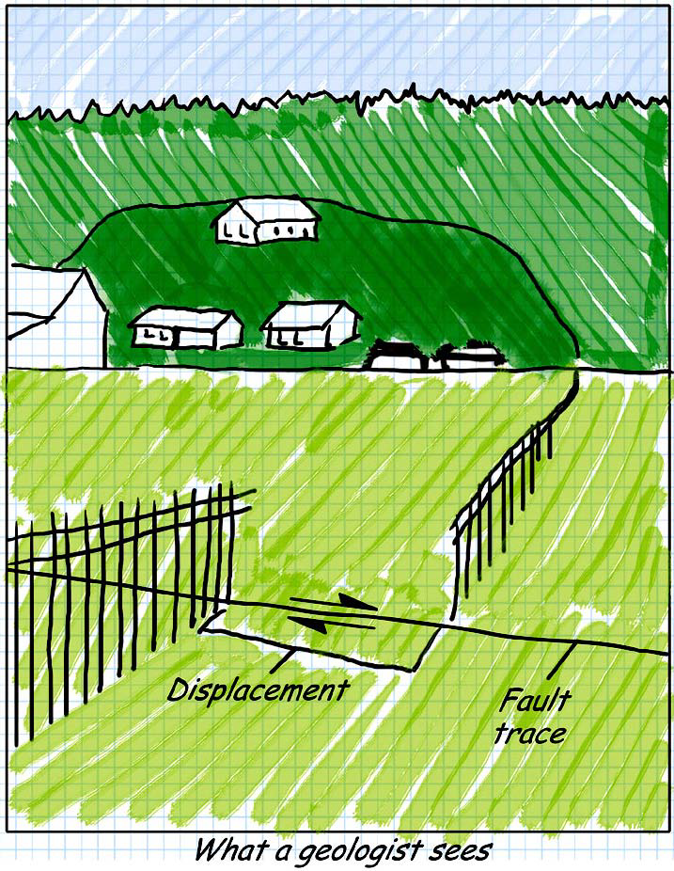
Measuring Motion Across a Fault

